Slide 1
Database Management Systems (CO1 Assessment Tool 3) TECHNICAL PRESENTATION
Student Name: D.Naveen Kumar
Register No: 192511401
Department: CSE
Course Code: CSA0508
Course Name:Database Management System

Slide 2
Q1: ER Diagram for Online Library System
Introduction
An Online Library Management System (OLMS) manages books, members, borrowing, returns, and fines using a centralized database.
A DBMS improves accuracy, security, and efficiency compared with manual record-keeping.
The ER model provides the conceptual design before database implementation.

Slide 3
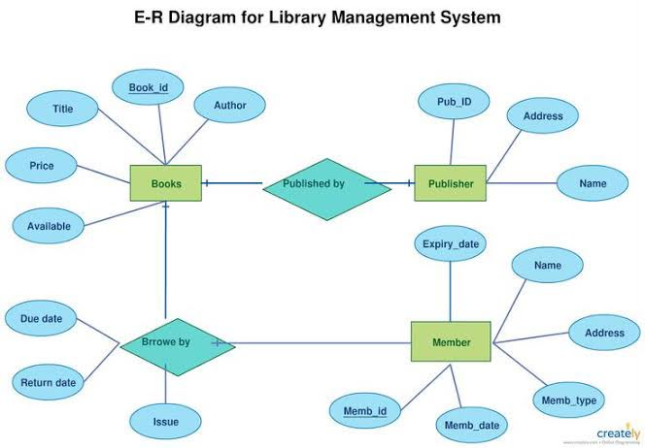
ER Diagram

Slide 4
Database Design
The Database Design Converts The Entity Relationship (ER) Model Into A Structured Relational Database. Each Entity Is Represented As A Table, While Relationships Are Maintained Using Primary Keys (PK) And Foreign Keys (FK). The Design Follows Normalization Principles To Reduce Data Redundancy, Improve Data Integrity, And Support Efficient Storage And Retrieval.

Slide 5
CASE STUDY: NATIONAL DIGITAL LIBRARY OF INDIA (NDLI)
Overview
* Developed by IIT Kharagpur under the Ministry of Education, Government of India.
* One of India’s largest digital library platforms providing educational resources.
Role of DBMS
* Stores books, users, authors, publishers, and borrowing records.
* Uses a relational database to ensure fast search, secure access, and efficient data management.
* Maintains data integrity using Primary Keys and Foreign Keys.
Key Benefits
* 📚 Centralized digital resource management
* ⚡ Fast book search and retrieval
* 🔒 Secure and reliable data storage
* 📈 Supports millions of users and educational resources

Slide 6
Q2: Enhanced ER Model
INTRODUCTION
* It represents complex real-world data more effectively than a basic ER model.
* EER extends ER by introducing Generalization, Specialization, Inheritance, and Aggregation.
Why EER?
* Models hierarchical relationships between entities.
* Reduces design complexity in large database systems.
* Improves database flexibility and scalability.
Applications
* University Management Systems
* Banking Systems
* Hospital Management
* E-Commerce Platforms

Slide 7
ER Model vs Enhanced ER (EER) Model
Feature | ER Model | Enhanced ER (EER) Model
Definition | Basic model used to design relational databases. | Advanced extension of the ER model for complex database design.
Main Components | Entities, Attributes, Relationships | Entities, Attributes, Relationships, Generalization, Specialization, Inheritance, Aggregation
Complexity | Suitable for simple databases | Suitable for complex and large-scale databases
Hierarchy Support | Does not support hierarchical relationships | Supports hierarchical relationships using superclass and subclass concepts
Flexibility | Less flexible | Highly flexible and scalable
Applications | Small library systems, student databases | Banking, Healthcare, University Management, E-commerce, Enterprise Systems

Slide 8
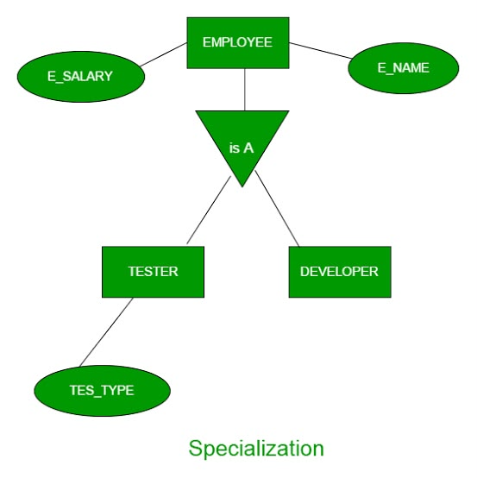
EER Diagram

Slide 9
Advantages & Applications
Advantages
Better data modeling
Reduces redundancy
Easy maintenance
Flexible design
Limitations
Complex implementation
Higher design cost
Industrial Applications
ERP
Banking
Healthcare

Slide 10
QUESTION 3: Data Independence
What is Data Independence?
Ability to modify database schema without affecting applications.
Types
Logical Data Independence
Physical Data Independence
Benefits
Easy maintenance
Scalability
Flexibility

Slide 11
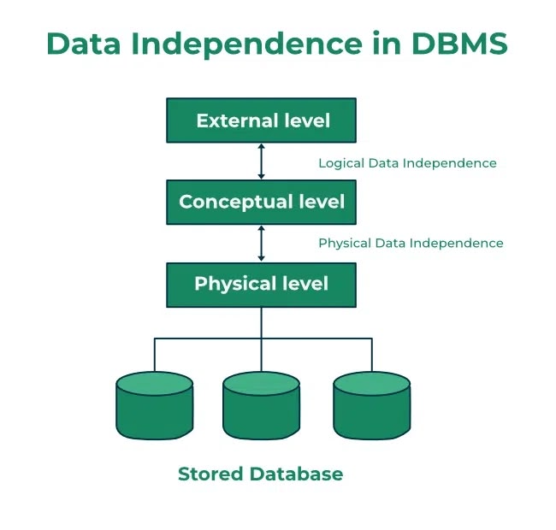
ANSI/SPARC Architecture

Slide 12
Logical vs Physical
Logical | Physical
Changes schema | Changes storage
Users unaffected | Programs unaffected
Easier maintenance | Better performance
Examples
Add new attribute
Change storage device

Slide 13
Applications
Industry Uses
Oracle
SQL Server
PostgreSQL
MySQL
Advantages
Easy upgrades
Data security
Cloud migration
Future
Autonomous Databases
Cloud DBMS

Slide 14
QUESTION 4: Software Components of DBMS
Introduction
Software Components
Main modules inside a DBMS.
Purpose
Query execution
Storage management
Security
Recovery

Slide 15
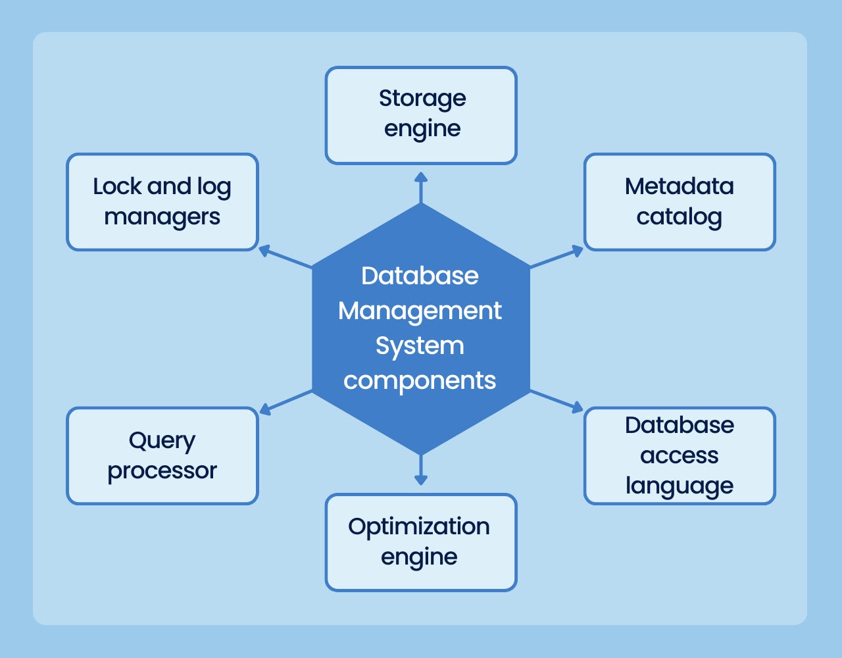
ER DIAGRAM

Slide 16
DBMS MODULE
Module | Function
Query Processor | Execute Queries
Buffer Manager | Memory Management
File Manager | File Storage
Transaction Manager | ACID
Recovery Manager | Crash Recovery

Slide 17
INDUSTRIAL ARCHITECTURE
Popular DBMS
Oracle
MySQL
PostgreSQL
SQL Server
MongoDB
Future
AI Optimization
Cloud DBMS
Distributed Systems

Slide 18
QUESTION 5: Strong Entity vs Weak Entity
Introduction
Strong Entity
Has Primary Key
Exists independently
Weak Entity
No Primary Key
Depends on Strong Entity

Slide 19
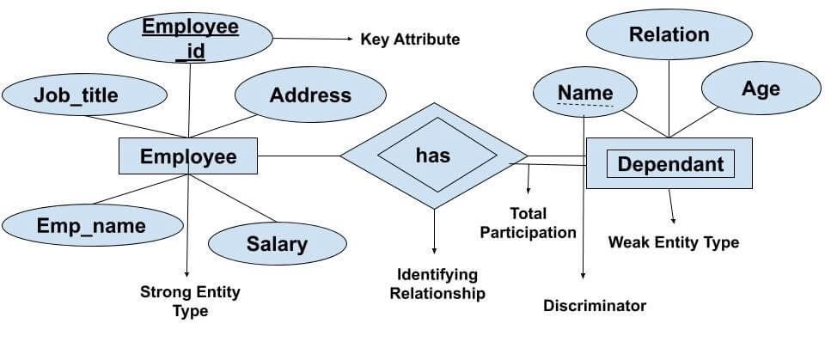
ER DIAGRAM

Slide 20
COMPARISION
Strong Entity | Weak Entity
Own Key | Partial Key
Independent | Dependent
Single Rectangle | Double Rectangle
Total participation not required | Total participation required
Examples
Strong:
Customer
Employee
Weak:
Order
Dependent

Slide 21
APPLICATIONS & CONCLUSION
Applications
Banking
Hospital
E-Commerce
Library
Key Takeaways
Strong Entity → Independent
Weak Entity → Dependent
Essential for ER Modeling
Improves database design

